Slide 1

@NewAngliaLEP
IDENTIFYING FUTURE SKILLS NEEDS IN NEW ANGLIA
Natasha Waller
Skills Manager
New Anglia Local Enterprise Partnership
Notes:
1

Slide 2
@NewAngliaLEP
What are Local Enterprise Partnerships (LEPs)
38 Local Enterprise Partnerships across England.
Business led partnerships between local authorities and local private sector businesses.
Determine local economic priorities and undertake activities to drive economic growth, create jobs, improve infrastructure and raise workforce skills within the local area.
Funded by Government
Notes:
2

Slide 3
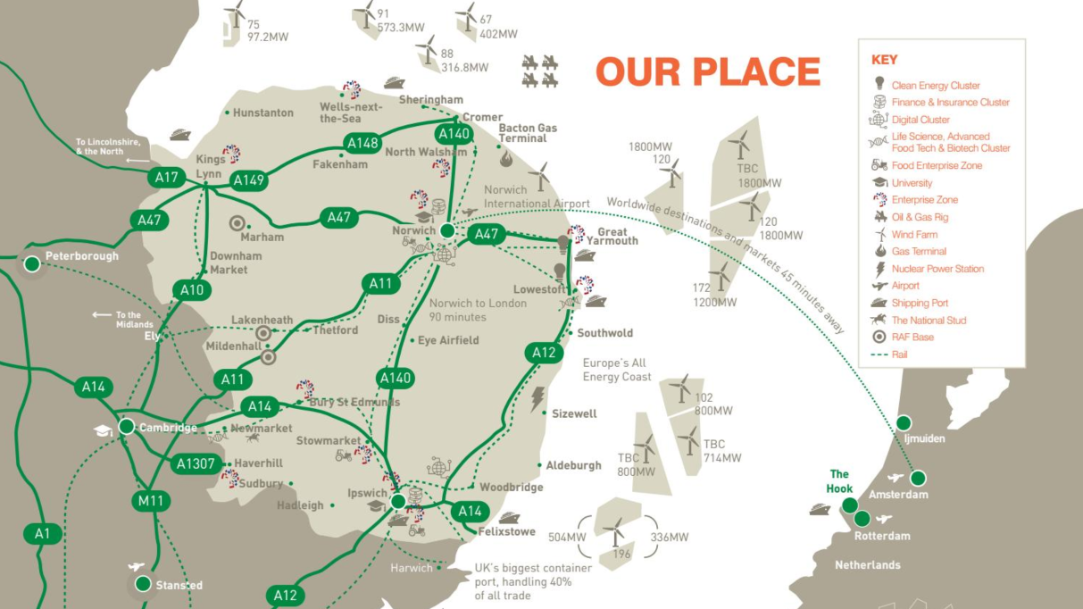
@NewAngliaLEP
Notes:
3

Slide 4

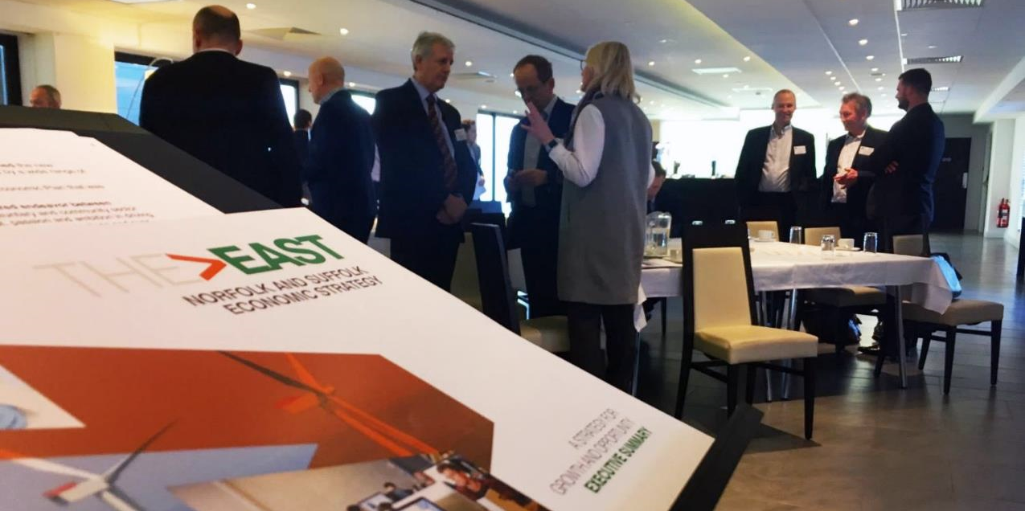
@NewAngliaLEP
Notes:
Throughout 2017, a number of stakeholders worked with the LEP to produce a new Economic Strategy for Norfolk and Suffolk. It includes a detailed evidence base, including people, demography and skills. You can find copies on our website.

Slide 5
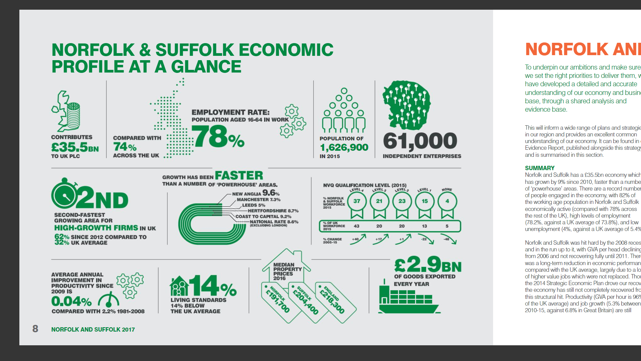
@NewAngliaLEP
Notes:
5

Slide 6
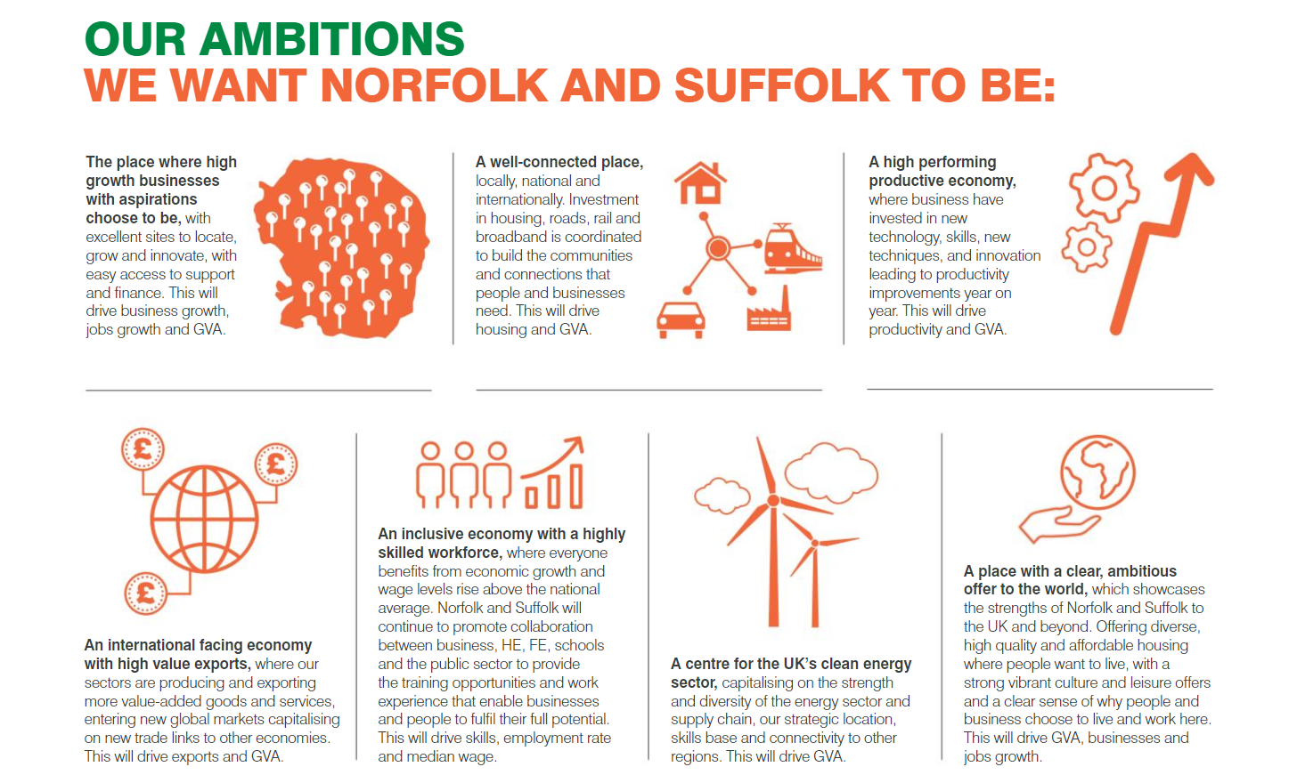
@NewAngliaLEP
Notes:
6

Slide 7
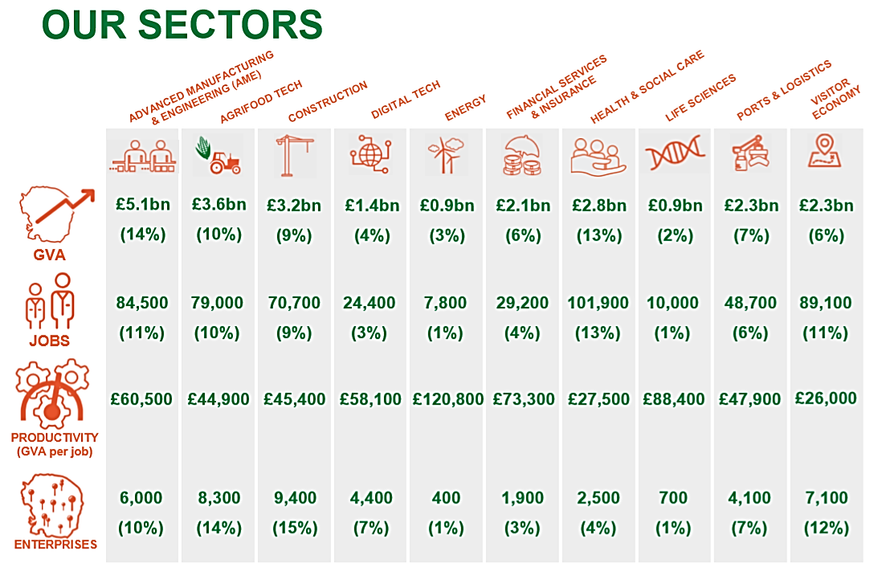
Notes:
Gross value added (GVA) measures the contribution to an economy of an individual producer, industry, sector or region. It is used in the calculation of gross domestic product (GDP).

Slide 8


@NewAngliaLEP

Slide 9
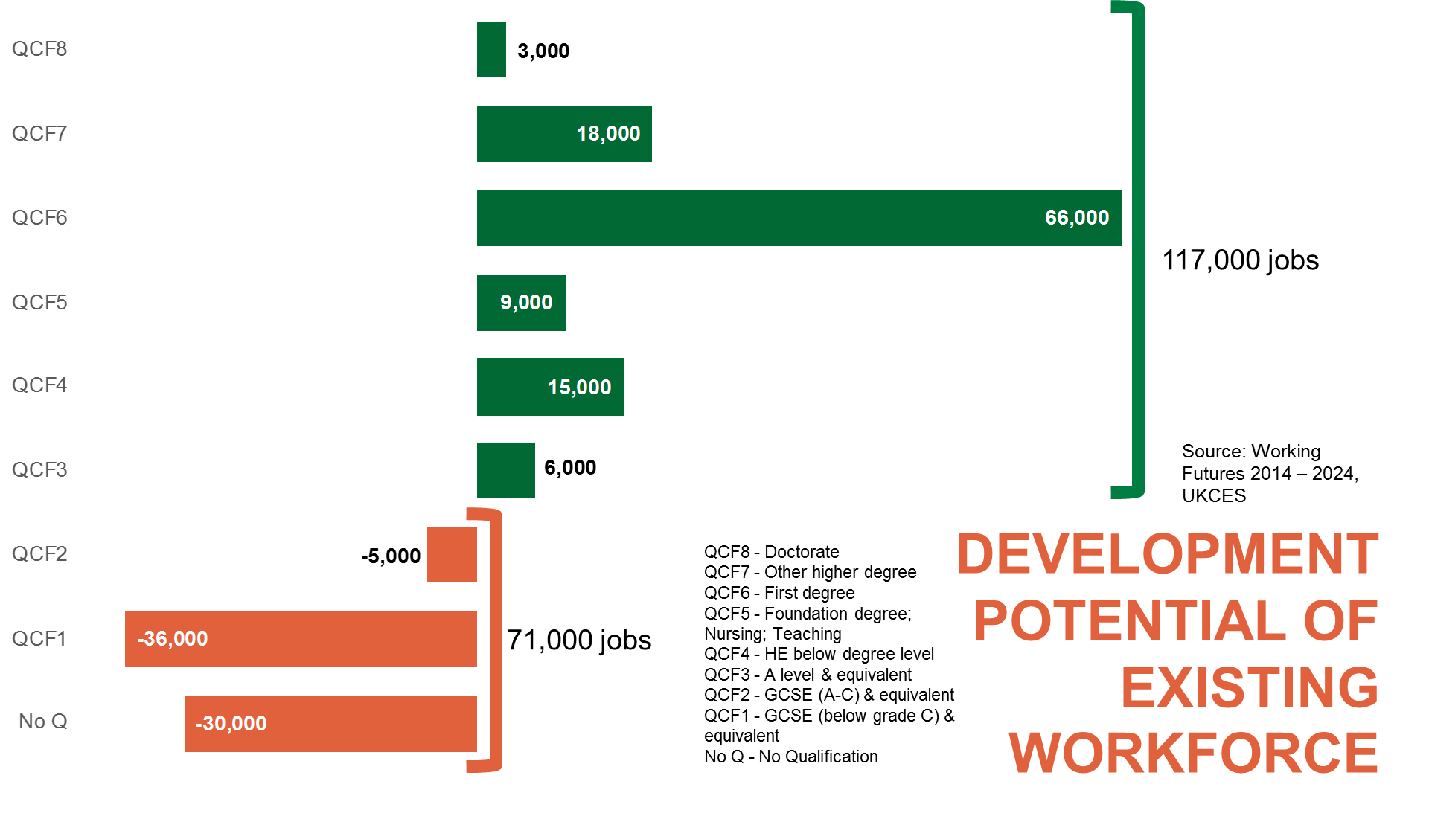
@NewAngliaLEP

Slide 10
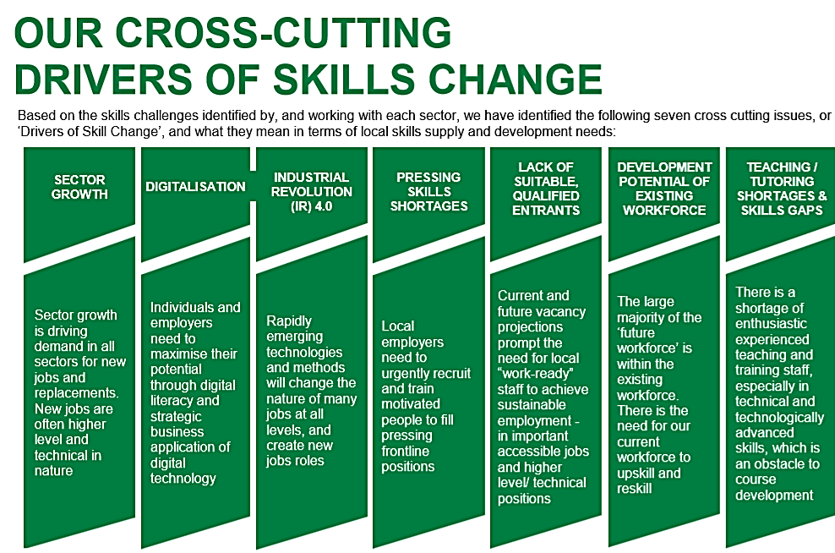

Slide 11


@NewAngliaLEP
Notes:
WHAT DO WE MEAN BY SECTOR SKILLS PLANS?
Skills in the widest sense
Bespoke to sector and New Anglia
Shared ownership
Robust evidence base
The employer voice
Forward-looking practical actions

Slide 12
AgriFood Tech sector skills plan actions
Co-ordinate sector careers provision to promote agrifood tech careers at all ages
Develop new progression routes to HE in agrifood tech – led by industry with Easton and Otley College
Develop new HE centre to meet the shortfall in technical HE in the industry
Develop the supply of trainers to meet the needs of agrifood tech sector skills providers
Develop a workforce development programme to equip the sector with the skills needed for growth

Slide 13


Industrial Strategy Overview
Government’s Industrial Strategy White Paper was published on 27 November 2017, setting out a long-term plan to boost the productivity and earning power of people throughout the UK.
Components of the Industrial Strategy:
Five Foundations of Productivity
Four Grand Challenges + Industrial Strategy Challenge Fund
Sector Deals
Local Industrial Strategies
The Government set up an independent Industrial Strategy Council to assess progress made and to make recommendations to the Government.

Slide 14
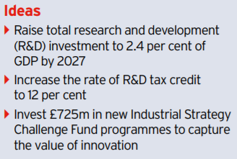
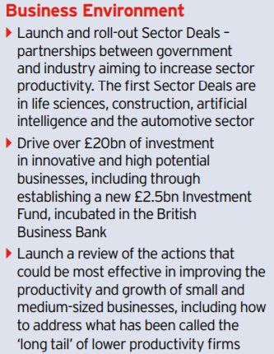

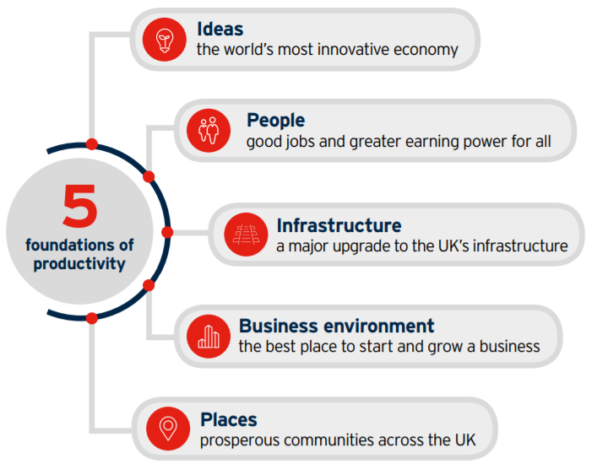
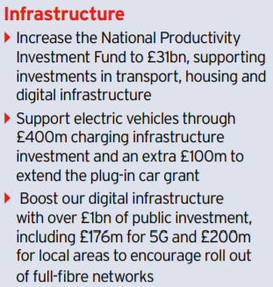
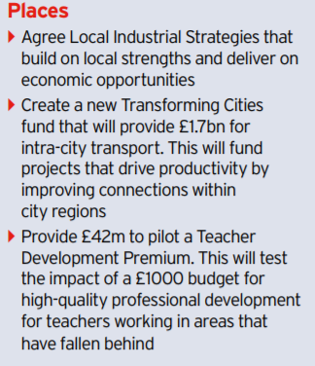
Foundations of Productivity

Slide 15
















The 4 Grand Challenges

Slide 16
Clean Energy
ICT
Agri-Food
Innovation Ecosystem
Notes:
The evidence from our Economic Strategy shows us that our comparative strengths lie in Clean Energy, Agri-Food and ICT – all sharing an innovation ecosystem to develop further, working across sectors to deliver those challenges. We are now in the process of updating the evidence to support the development of the Strategy.
These areas have been chosen at the start because:
Norfolk and Suffolk is the only place in the UK where all forms of resource extraction and energy generation exist together, including expertise on microgeneration and growing local energy networks.
The region is home to major ICT assets - both Ipswich (£372m GVA) and Norwich (£395m GVA) are recognised as mature digital tech clusters by Tech Nation and we have Adastral Park on our doorstep.
The New Anglia LEP area is the most productive farming region in the UK and hosts many nationally and internationally significant food and drink companies which specialise in a wide range of food production and processing.
We will be consulting stakeholders to enhance both our quantitative and qualitative evidence around the Grand Challenges and these focus areas to cover off the foundations of productivity and come up with exciting game-changing opportunities that we can invest in to align interventions with boosting productivity and earning power in our region, and in turn contributing to the delivery of the Economic Strategy for Norfolk and Suffolk. The input of business is crucial to help formulate these investment opportunities.

Slide 17
@NewAngliaLEP
Natasha.Waller@newanglia.co.uk
https://newanglia.co.uk/our-economic-strategy/
https://newanglia.co.uk/sector-skills-plans/
https://newanglia.co.uk/local-industrial-strategy/
Notes:
17

